Slide 1
Consolidated slide deck – Presentation to Prakash
Week of 7/16-20/2018

Slide 2
INGESTION MONITOR
Ingestion monitor identifies whether a set of execution fails by the status shown as red as failed, green as success or yellow with some error like validation.
Detail table shows all the audit details like Phase, ECN, Process Status and Timestamp it happened
Expanding the master UI table displays the Hogan filenames being processed in a particular day.
Expanding the detail UI table (the record that flagged error) displays error validation of all fields based on business requirements.

Slide 3
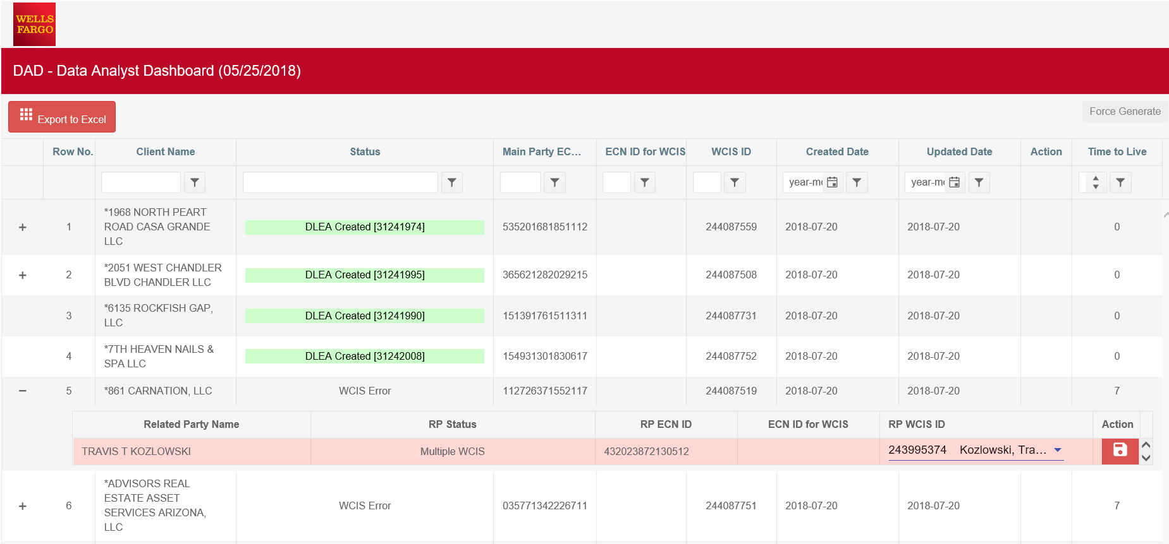
DATA ANALYST DASHBOARD

Slide 4
DATA ANALYST DASHBOARD
Shows the hierarchical structure of main parties and the corresponding related parties.
It also displays the post processing status of all main and related parties after it reached the target cache.
Expanding the UI table displays the related party information including the action the you user wants to take place. (In the sample screen shot, there’s a multi WCIS)

Slide 5
UI Technologies
Both ingestion monitor and data analyst dashboard are made from Angular 2 using the Kendo UI widgets.
Data are loaded using the exposed REST API from mule.
Both UI are secured by the bank’s Channel Secure.
Running on clustered Tomcat server.

Slide 6
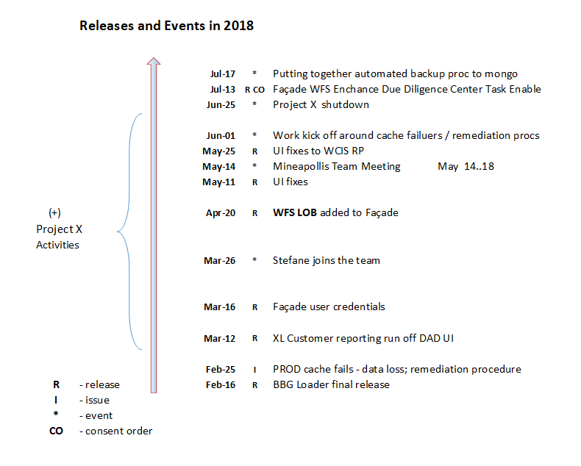
Timeline

Slide 7
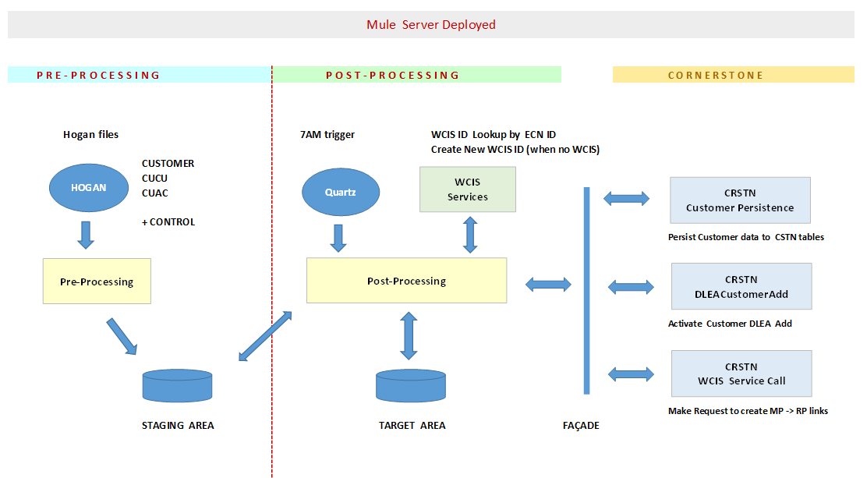
BBG Loader Flow – Customer transitions from Hogan to Cornerstone Released in Feb-2018

Slide 8
Everyday BBG Loader Processing Routine Daily run combines 2 parts
1. Pre-processing
* Hogan file drop off triggers processing (at any time – when all 6 files become available)
* Process does data “stitching” (CUCU <= CUST + CUAC)
* Validation is performed
* Storing validated data into STAGING AREA + reporting issues in IM
2. Post-processing Then the 2nd part kicks around 7:00am
* Trigger event arrives to system
* Data is being pulled in - from STAGING AREA to process
* Initial filtering out takes place for ECNs that has already been on DLEA_CREATED status
* All records that has passed step ‘c ‘ are stored into TARGET AREA and removed from STAGING
AREA WCIS service calls take place
* Status updates are performed and stored to TARGET AREA customer records (basically is and
outcome from WCIS calls)
* CRSTN mapping gets done for some of the Hogan fields
* Normalization (WFS related) takes place for Customer JSON
* Submission to CRSTN takes place
* Response from CRSTN (or the timeout) is processed and logged to TARGET AREA

Slide 9
Mainstream Activities – BBG Loader Platform Stability and Performance
BBG Loader caching mechanism replacement as Coherence does not offer reliable persistence store
Data loss risk prevention : ongoing daily routine to secure BBG Loader data – process automation
Cache restore mechanism while using Mongo source
Benefits from change:
Loader stability /node failover, guaranteed persistence/
Performance increase /needs eval/

Slide 10
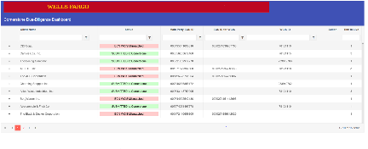
B B G L O A D E R
FACADE
PRE-PROCESSING
POST-PROCESSING
CORNERSTONE INVOCATION
HOGAN
Quartz
WCIS
WCIS
CRSTN
Grouped by Revision:
Customer
CUCU
CUAC
+Control (3)
New ECN
Single ECN
Multiple ECNs
7 AM
Trigger
Link
Customer
BPM
Initiation
Hogan Files
Replacing unreliable caching mechanism with replicated persistent store
Pre-Processing
(Mule)
POST-Processing
(Mule)
DLEA FACADE
(Mule)
STAGING AREA
TARGET AREA
CORNERSTONE
DATABASE
INGESTION MONITOR
DATA ANALYST DASHBOARD

Slide 11
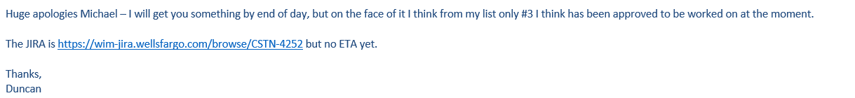
Mainstream Activities - Relevance to Duncan, CRSTM Team
1. Holding off on sending Customer MP data to CRSTN by 24-48 hours in cases where the new Wcis-ID request is made by BBG Loader (MP, RP levels) – just to mitigate risks around WCIS remapping (performed intraday) {Duncan request}
2. Email batching in mule to replace existing mechanism in BPM {Aamir request}
3. Eliminating situations where circular references can be created between MP and RP parties {Duncan request}
4. “Mongolizing” BBG Loader data store to ensure data persistence for BBG Loader (work-in-progress) {myself}
Benefit coming from change #3:
Eliminating DUPs - circular references between Customer Main and Related parties

Slide 12
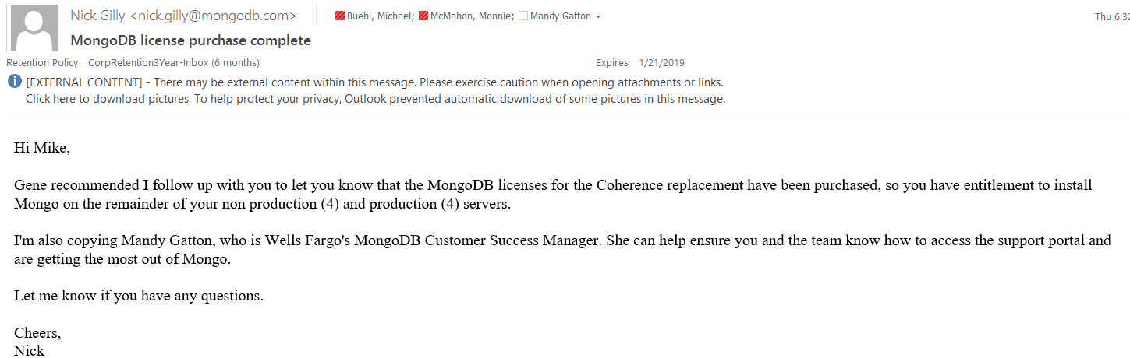
Mainstream Activities - Relevance to Duncan, CRSTM Team
5. Infrastructure effort – Setup for Mongo in PROD. {Onboarding for MongoDB, Mule Support, WF Mongo Arch.}
6. WCIS service extensions – supplemental enhancement works on BBG Loader services for additional data
provisions {Duncan }
7. Last but not least … WFS service changes {Ravish}
Benefits from change #5:
Provisioning an enterprise grade caching solution.

Slide 13
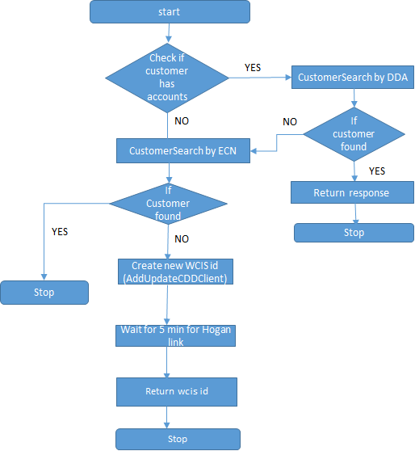
WCIS Integration –Post processor
WCIS Integration –Facade
WCIS:Check Volker Flag Set for Customer
STOP
NO
Facde specific Invocations
WCIS:ProcessRelatedEntity

Slide 14
DELIVERED
Adding Additional Fields in WCIS customer creation : CSTN-3592
Adding ECN to WCIS Id creation : ALM 9711
BAU: Jaxon jar update to v. 2.9.5 as requested by Mule Support:
Implementation of ProcessRelatedEntities for establishing MP-RP relationship
BBG: Limit IM screen with 30 days records:
BBG: Drop off the RPs having invalid cucuRelCode Before WCIS Enrichment
Implementation of Mule Credential Vault for Post processor and Façade.
Development of Routine for dataload: for Backup & Restore
Supporting the Production deployments for BBG.
Implementing changes in post processor ,as part of removing coherence events.
Migration of updateCustomer from Coherence Services to post processor
Data load from PROD to DR
Analysis of refactoring the Facade code to 3 layer design
Implementation of Customer Verification service
Implementation of Customer RiskAttributeService Prc-Api
Creating RAML for Coherence Services
IN PROGRESS
QA Testing going on Validate Tax IDs for BBG Look UpsCSTN-3925,
Working on the Orchestration document for the composite services

Slide 15
FaçadeAPI
Cornerstone Database[ 21 Tables]
WCIS – Volcker Flag Validation & Create Relationship between main party and related party
BPM – Initiate DLEA
FileNet Service – To upload document
BBG
WFS

Slide 16
Summary of works
Delivered
BBG Cornerstone Integration – Automated Interface
CSTN-2530 - Wells Fargo Securities (WFS) / Cornerstone Integration - Automated Interface (Phase 1)
CSTN-2582 Include Related Party Information in Data Feed - OK
CSTN-2583 Match drop-down values between Cornerstone and WFS applications
CSTN-2586 Align disregarded entities between WFS and Cornerstone
CSTN-2586 - Align disregarded entities between WFS and Cornerstone
CSTN-2990 - Introducing Volcker Flag Check before enrolling customer to Cornerstone
CSTN-2609 8.0 - Triggering EDD in WFS will automatically select the 'EDD Required' option on the DLEA in Cornerstone
Added support for SARF and LOB specific SARF
CSTN-3706 - WFS API: Main Party - EDDC option is not selected as per request JSON in DLEA page UI.
CSTN-3707 -WFS facade API - New field "foreignToBookingInd" data not displayed correctly in CSTN UI.
CSTN-3518- DLEA completed without submitter filling in all required fields
Enhance API to accept country of booking, OUS information and accept CIP notice status.
Enhance API to accept :
Source of Funds for Initial Deposit
Nature and Purpose of Account
Enterprise prohibitions associated with the main party
In Progress – Aug Release
CSTN-4261: Enhance existing create DLEA API for doc upload to MP and RP.
CSTN-4183 : Enhance DLEA API to support SODD
QA support and release management for BBG and WFS
Work going on at refactoring API
Prepared Business Use Case document
Part of designing canonical object
Working on sys-api to find out list of endpoints.

Slide 17
‘apiteam’ Integration Factory
Started as ProjectX with the objective of rewriting fundamental pieces of Cornerstone and address all current shortcomings:
Audit trail, snapshots, single source of truth, performance, replays, DR, shifting complex logic on to a light-weigth SOA infrastructure.
Objectives since May:
Building a factory automation to quickly deploy new integrations using APIs
Maven, Jenkins CI/CD, TDD/Munit/Junit, Mule/Java/REST, WSO2 (Authentication & policies)
As of today: We take a TDD approach to building anything:
Business use cases, build happy and rainy path test cases, implement Munit, run Jenkins watch the build fail, build the code supporting the failing test case(s) until the build succeeds. Upon successful build, deploy the new artifact to the DEV server, run a BDD end-to-end test suite against an experience-API (traversing all 3 layers). Report to scrum meeting, add jira to address a fix either as a feature or as a hotfix. CI/CD again with full regression.
Our wish: to work closer to a BA, receive better support by sysOps for enhanced automations and work with LOB dedicated QA team to involve them in our agile/BDD/TDD approach from day 1 and shorten release cycles.

Slide 18
Monolithic Facade – single contract across al LOBs – tightly coupled to all external services
Customer on-boarding request into Cornerstone
Code mix of contract, orchestration, LOB specific logic & CRUD operations (database). Code forced to accommodate specifics of al LOBs. No process API layer. Difficult to map business use cases and tests cases to measurable API responses without inspecting the database before and after any request. Database operations are all sequential and require transactional state.
Instead more analysis has shown how to parallelize every insert to the database and rollback by using a simple compensation mechanism on well known correlationIDs. Invocation of external endpoints are tightly coupled.
BBG contract
GE contract
WCIS
WFS contract
Current Façade (single API)
Request validation
Orchestration logic
JDBC logic
DLEA
FileNet
Cornerstone Oracle DB
Notes:
History: The current façade was built for BBG (start July 2017) as an extension of 2 other integrations pre- & post- processing and w/o mention that WFS would piggy back on the façade solution (Jan 2018). There was no seasoned API architect providing guidance at the time on how to address a single integration with multiple contracts and build a loosely coupled architecture with complete separation of concerns. The current integration only handles New Customer on-boarding. Phase 2 requirements (new ones) for WFS are already in discussion for supporting – customer updates from eCache. We hear about development start around Q4 2018 or Q1 2019. Currently the façade does only support PODD and there are conversations to start supporting SODD as well.
It is clear at this stage that more functionality will be added and the solution deserves a robust, scalable, loosely coupled architecture, which is the purpose of this early refactoring.

Slide 19
Cornerstone On-Boarding Service - 3 layer architecture
BBG-OnBoarding-exp-api
WFS-OnBoarding-exp-api
GE-OnBoarding-exp-api
OnBoarding-prc-api
Currently not in plan (ProjectX)
OracleDB-OnBoarding-sys-api
MongoDB-OnBoarding-sys-api
Cornerstone Oracle DB
Cornerstone MongoDB
Notes:
This new architecture allows all LOBs to function separately (custom contract) while supporting the same business process functionality.
The process API works in canonical object form, the 3 experience APIs translate any LOB contract into canonical. The Process API is free of implementation concerns, unaware where and how to persist the data. The system api or adapter takes care of this. Down the road if/when NoSQL on MongoDB proves to be a more efficient implementation layer (because structurally identifcal to the canonical model) the only artifact that will be changing is the system API. IF Oracle DBMS gets upgraded or the DBMS schema updated, only the adapter will be affected. It will then expose a new API version to the process-API. All 3 layers carefully expose an API version which allows for new versions, change of contracts while maintaining backward compatibility.

Slide 20
Securing the Cornerstone On-Boarding APIs
OAUTH (*) or CUSTOM TOKEN
BBG-OnBoarding-exp-api
WFS-OnBoarding-exp-api
GE-OnBoarding-exp-api
TOTP
OnBoarding-prc-api
TOTP
DLEA-sys-api
Oracle-OnBoarding-sys-api
FileNet-sys-api
WCIS-sys-api
Cornerstone Oracle DB
(*) OAUTH will be supported by an API-manager e.g WSO2AM
Notes:
Currently the façade is expose to unauthorized users because it was only built with functionality in mind but not security. Nothing prevent accidental cross environment invocations or an LOB to invoke the façade with other LOB data. There are no network isolations in place or 2-way SSL or API policies enforcing white/black-listing or throttling or blocking DoS attacks.
The new architecture envisions the use of an API-manager and best of breed security mechanisms such as Oauth and TOTP.

Slide 21
Purpose for façade Refactoring
To address critical limitations and shortcomings of the façade v1:
. APIs not built following REST API best practices. It has been built in a point-to-point approach (hard-coupling between multiple external services: FileNet, WCIS, DLEA (BPM) & OracleDB (Cornertsone DBMS). Not a recommended approach in the industry: works today, breaks tomorrow.
API built for one LOB, then refactored for the 2nd LOB causing dependencies between LOBs, requiring a full regression of the LOB deployed first. What happens when a 3rd, 4th, 5th LOB come into play? The feature set keeps growing from its original scope w/o a clear path to expose those new methods through API or how to address the separation between LOBs.
API was not built with any versioning in mind. When a single business requirement changes on any of the consuming LOBs , the code requires re-factoring in a way that other LOBs are impacted in the way they contract with the API.
No canonical model used, no one has a clear idea of what the core business objects are to support Cornerstone on-boarding.
API was built with the DBMS model constraints in mind rather than with the business requirements in mind. As a result, the façade is a patchwork of DBMS insertions mixed into middleware orchestration code, mappings dictated by DBMS entity relationships rather than by true business logic at core.
API was built by a team rather novice to Mulesoft – and in particular in REST API architecture; as a result API is not leveraging some of Mulesoft essential OOTB features or classic production longevity concerns.
No High-availability, no replay strategy.

Slide 22
3-layer API architecture refactoring to address shortcomings
With a 3-layer API architecture we approach the on-boarding concept from a strict business stand-point, building core components first:
1. An enterprise canonical model that supports all aspects of Cornerstone on-boarding
2. A collection of micro and composite services (30 total) able to be consumed by any client through out the enterprise including by the Cornerstone BPM (possibility) by externalizing some of the logic that currently bloats the BPM.
3. An REST API clean version scheme to account for future business requirements changes while maintaining backwards compatibility and the ability to run multiple versions of the API if necessary.
An distinct experience API for each line of business, removing any kind of dependencies on LOBs API contracts. The experience API allows an LOB to send data readily available without having to comply to an LOB-common contract or incur internal re-factoring to comply to the minimum Cornerstone on-boarding requirements.
A distinct adapter for each external service: one for OracleDB, one for FileNet, one for DLEA, one for WCIS. The last 3 ones have a lower priority due to the fact that WCIS, FileNet and DLEA already expose a REST API (not properly versioned either).
The 3-layer API is the only recognized blueprint in the API industry to support loose coupling between all concerns.
The experience-API allows a consumer or a consumer group to submit any JSON payload representative of their current capabilities or constraints.
The Process-API is the business machine, speaks business, thinks business, supports all operations of the business in a model understood by the entire enterprise (canonical model).
The System-API (or adapter) translates business operations to CRUD operations of the implementation (DBMS, SaaS, noSQL, caching, any transport: JMS, REST, SOAP, FileSystem, FTP…). It deals only with persistence concerns and allows the process layer to be free of implementation logic.
APIs will be secured using best-of-breed industry authentication mechanisms (oAuth, TOTP)

Slide 23
DJ Team originally focused on establishing the Infrastructure for project
The infrastructure being put in place is regarded as the best of bread tooling and practices in SOA and API enablement
DELIVERED
Environment independent SOA stack: mule, wso2am, DBMS or NoSQL, rabbitmq,
Mule 3.9.0 – limited (due to Jackson libs removal) or Mule 3.8.7 - full bundle
Single repository in github EE – for single build of the whole project suite using maven
Gitflow branching strategy – Gitkraken as source control client
Maven configuration – build anywhere based on developer/server profile
Mule 3 layer architecture templates: experience, process, system
Domain template for single listener shared resource across all APIs
Security – Transport encryption – TLS
Authentication between APIs – Time-based One-Time password
CI/CD with Jenkins, mule-maven plugin
Agile project methodology – daily scrum – 2 weeks Sprint management
Enterprise-wide Canonical data-model for Cornerstone on-boarding
BDD using gerkhin/cucumber for UI or REST/SOAP APIs
IN PROGRESS
TDD using mule IDE built-in Munit or Junit (Sprint 8 = current sprint, is following TDD approach)
API visibility – management – policies – governance with WSO2 Api-Manager
Stress/Load testing using Jmeter or postman

Slide 24
‘apiteam’ Infrastructure re-use
For Cornerstone
GE LOB on-boarding or any on-boarding data from other external systems e.g. various CRM systems we have heard about
New features for the OnBoarding façade should be added post-refactor (Q4 2018): Simplified On-Boarding, WFS Customer Data updates
Offloading the BPM existing service catalog (120-30 methods total, domain by domain, 7 domains).
Offloading the Entitlement service currently built in the BPM and proxying between Active Directory and the Rules Engine.
…reducing unnecessary complexities and implementation logic in the BPM
Adopt TDD and daily build approach
Outside of Cornerstone
Mediate all tightly coupled integrations through mule and simplify/reduce code complexity at endpoints
Reduce the number of scheduled jobs
Reduce the number of ETLs
Eliminate integrations operating as ETL (move data from A to B, then move it from B to C, because of fear of loosing data that can easily be lost, resent, replayed.
WCIS appears to be an excellent candidate to adopt an ESB for the following reasons:
Proxy WCIS and alleviate the number of daily calls through caching, payload reduction and methods of lesser granularity
Proxy WCIS by queueing calls or implement asynchronous calling to WCIS
Apply governance to WCIS, prioritize callers.
Apply/evangelize a canonical model
Delegate the complexities of merging, duplications… to the middleware.

Slide 25
Cornerstone Service Catalog
From the Minneapolis week: May 14-18
A collaborative analysis produced the following Service Inventory
Source: 10 days of Production Splunk logs scanning by Ted, Shomu API methods inventory & refinement by Pravin and other Cornerstone team members.
Source https://wfs-confluence.wellsfargo.com:8443/display/CRSTN/Service+Catalog (CRSTN_Service_Catalog_v02.xlsx)
The take away was that Cornerstone has many services built-in but only log analysis tells us what is used and what not as well as how frequently certain service calls are being invoked. The BPM code base is overwhelmingly vast to conduct such analysis through code inspection. Another observation is that the BPM code inspection is tedious through its native 4GL interface. Any application whose code analysis or review is better achieved through log scanning has clearly serious challenges at hand.
The inventory is organized in 7 main groups (the former domains) + other ancillary features of low/rare usage.
Shomu and Pravin showed a good handle on the catalog overall with now and then a few methods to clarify further.
Customer-Master is the most critical group in the collection of 7 and the most popular domain in terms of requests.
It is interesting to note the WCIS Integration, also an important domain which could be easily offloaded to mule if the WCIS service offering to adopt an ESB and mediate their calls through mule. Main benefits would be to implement caching (where appropriate), reduce traffic and bandwidth by exposing
thin-APIs (payload subsets) and ease the load on WCIS. We hear of performance or response time issues from time to time.
The architecture draft discussed in Minneapolis was to deploy 7 API-based integrations (following the 3-layer API pattern).
with CustomerMaster being the first pilot of former projectX.
It would be a minimal effort to expose the CustomerMaster process API (quick RAML console poc)
based on the following API methods (see next slide)

Slide 26
CustomerMaster API – pilot on hold (part - 1)
In github: https://wfs-github.wellsfargo.com/CRSTN/ProjectX/tree/develop/mule/pilots/customerMaster-exp-api
/customer:
/persistCustomer:
/search:
/{customerID}:
/checkCustomerInClientMerge:
/customerExists:
/getAVACAAPAlerts:
/getCstnAttestations :
/getCstnCountryList:
/getCustomerAffiliateLockFlag:
# new method instead of getCustomerDetails, getCustomerInfo, getCustomerData
/getCustomer:
# /getCustomerData :
# /getCustomerDetails:
/getCustomerEddcQA:
/getCustomerEddcSarf:
# /getCustomerInfo:
/getCustomerProducts:
/getCustomerRiskRatingAttributes:
/getCustomerSarf:
Continues on next slide

Slide 27
CustomerMaster API (part 2)
/getEntitiesRelationshipEdd:
/getLegalHierarchy:
/getOUSBookingEntities:
/getPubliclyTradedAndCIP:
/getSARF:
/isPrimaryAccountHolder:
/loadCustomer:
/persistActivityMonitoringAlert:
/persistCstnAttestations:
/persistCustomerEddcSarf:
/persistEntitiesRelationshipEDD:
/receiveCaapAvaAlerts:
/search:
/searchDocuments:
/setCustomerSarfIdentifiedDate:
/setDESource:
/setEDDRequiredIndicator:
/setNextPeriodicReviewDateForAllCust:
/setNextPeriodicReviewDateForCust:
/suspendCustomer:
/terminateCustomer:
/triggerWCIS:
/unLinkCustomer:
/UnsuspendCustomer:
/wcisAddressValidation:

